Slide 1
FileTable

Slide 2
Agenda
Introduction
How to set up
Monitoring FileTable

Slide 3
Introduction
FileStream:
1.Most of data created every day is unstructured data, which is stored outside the database , e.g. text documents, images, and videos.
2. FILESTREAM integrates the SQL Server Database engine with an NTFS file system by storing varbinary(max) binary large object (BLOB) data as files on the file system.

Slide 4
Introduction
FileTable is the next generation of FileStream
This feature allows to store unstructured file system data, such as files and directories, on a special table called FileTable in a relational database
Also we can access this data stored on FileTable from Windows applications as if they were stored in the file system

Slide 5
Prerequisites for FileTable
1. Enabling FILESTREAM at the Instance Level
In the SQL Server Configuration Manager, locate the instance of SQL Server on which you want to enable FILESTREAM.
Right-click ->Properties., click the FILESTREAM tab.
Select the Enable FILESTREAM for Transact-SQL access check box.
If you want to read and write FILESTREAM data from Windows, click Enable FILESTREAM for file I/O streaming access. Enter the name of the Windows share in the Windows Share Name box.
If remote clients must access the FILESTREAM data that is stored on this share, select Allow remote clients to have streaming access to FILESTREAM data.
Click Apply

Slide 6
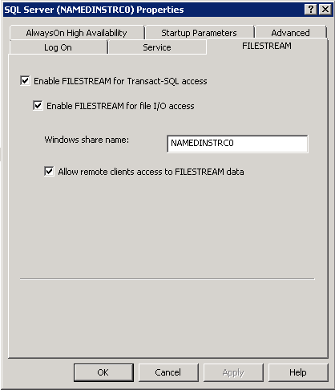

Slide 7
Execute following query in management studio,
EXEC sp_configure filestream_access_level, 2 RECONFIGURE
Filestream access levels
0 :: Disables FILESTREAM support for this instance.
1 :: Enables FILESTREAM for Transact-SQL access. ( if we set filestream access level to 1 we will not able to access or open the files directly , have to access it by running query only)
2 :: Enables FILESTREAM for Transact-SQL and Win32 streaming access.

Slide 8
2. Create a FILESTREAM-Enabled Database
CREATE DATABASE Archive ON PRIMARY ( NAME = Arch1, FILENAME = 'c:\data\archdat1.mdf'),
FILEGROUP FileStreamGroup1 CONTAINS FILESTREAM( NAME = Arch3, FILENAME = 'c:\data\filestream1')
LOG ON ( NAME = Archlog1, FILENAME = 'c:\data\archlog1.ldf') GO
(c:\data must exist before running this query )
Note: Primary filegroups cannot contain FILESTREAM data, so one more filegroup of type FILESTREAM is created in this database.

Slide 9
3. Specifying a Directory for FileTables at the Database Level
ALTER DATABASE Archive
SET FILESTREAM ( DIRECTORY_NAME = N'directory_name')
In the FileTable folder hierarchy, this database-level directory (directory_name)becomes the child of the share name specified for FILESTREAM at the instance level, and the parent of the FileTables created in the database.
We have given share name at instance level as NAMEDINSTRC0 ( refer slide 6 ). So now hierarchy becomes \\machine name\NAMEDINSTRC0\directory_name

Slide 10
4. Enabling Non-Transactional Access at the Database Level
Accessing filstream data through Windows applications is called as non-transactional access.
We have to specify the desired level of non-transactional access at the database level for each database that will contain FileTables.
The available levels of non-transactional access are FULL, READ_ONLY, and OFF.
OFF :: can not access the files , have to access files T-SQL only
READ_ONLY:: can not update or copy paste new file to the file table directory
FULL:: can do all opeartion including updating file, also can copy paste new file in the filetable directory.
ALTER DATABASE database_name SET FILESTREAM (
NON_TRANSACTED_ACCESS = FULL)

Slide 11
5. Creating FileTable
FileTable is a specialized user table that has a pre-defined and fixed schema
CREATE TABLE DocumentStore AS FileTable
WITH ( FileTable_Directory = 'DocumentTable‘)
This will create table named as DocumentStore and now hierarchy becomes \\machine name\NAMEDINSTRC0\directory_name\DocumentTable

Slide 12
Load Files into a FileTable
Start->run-> \\machine name\NAMEDINSTRC0\ directory_name\DocumentTable
Here
NAMEDINSTRC0 is the share name which we given while enabling FILSTREAM at instance level ,
directory_name is database direcotry name which we have given while enabling filstream at database level and
DocumentTable is fileTable directory which we have given while creating file table.
Now we can copy paste any type file to this path and that file information will get stored in filetable DocumtStore

Slide 13
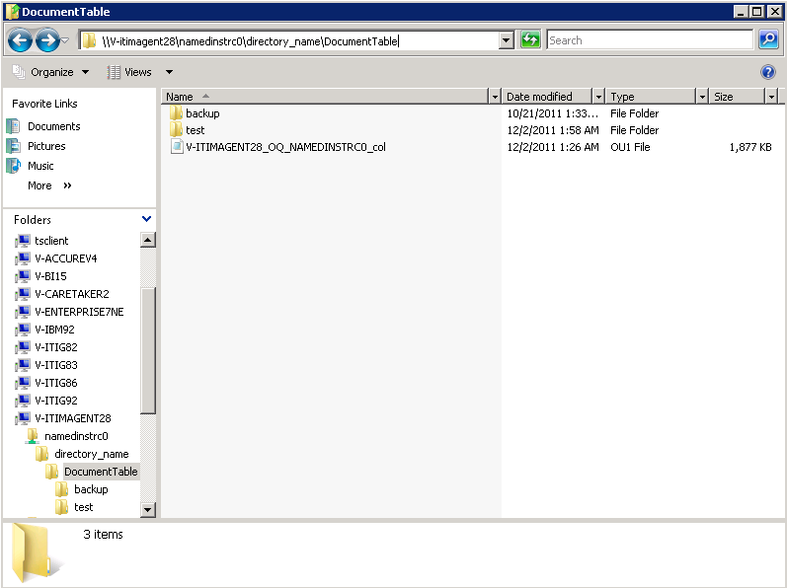

Slide 14
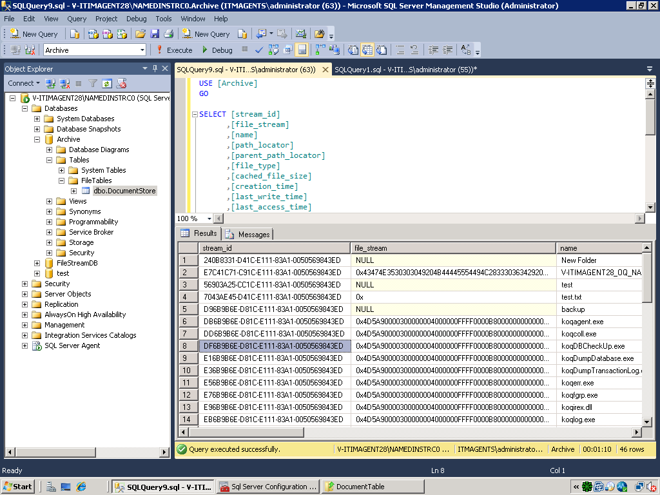

Slide 15
Access FileTables with Transact-SQL
INSERT : we can create new file or directory at this location by using INSERT query on FileTable DocumentStore
DELETE: We can delete file at this path by running DELETE query through management studio
UPDATE:: Updates can be made to the FILESTREAM data in the file_stream column ( of FileTable) without affecting any of the other columns, including the timestamps

Slide 16
Access FileTables with File I\O APIs
For accessing FileTable data through file I/O APIs , the non transaction access level must be read_only or FULL
Create::
A file or directory can be created in a FileTable by calling file I/O APIs such as CreateFile or CreateDirectory
The creation of a new file or directory corresponds to the creation of a new row in the underlying FileTable
Update or Write ::
Can also update or write new data in file using file I/O APIs, which results in updates of the corresponding file_stream and file attribute columns in the FileTable.
Delete::
Deleting a file or directory removes the corresponding row from the FileTable.

Slide 17
Monitoring FileTable
Catalog Views
sys.database_filestream_options :: Displays information about the level of non-transactional access to FILESTREAM data in FileTables that is enabled
sys.filetable_system_defined_objects :: Displays a list of the system-defined objects that are related to FileTables.
sys.filetables :: Returns a row for each FileTable. Inherits from sys.tables.
sys.tables :: Added one column as is_filetable , to show table is files table or not

Slide 18
Monitoring FileTable
Dynamic Management Views
sys.dm_filestream_non_transacted_handles ::
Displays the currently open non-transactional file handles associated with FileTable data.
This view contains one row per open file handle
view does not contain historical information
Counters
SQLServer::FileTable

